Slide 1
__ _____ ___ ___________ _______ _______ _____ ___ _______ ___________ |" \ (\" \|" \(" _ ")/" "| /" \ (\" \|" \ /" "|(" _ ") || | |.\\ \ |)__/ \\__/(: ______)|: ||.\\ \ |(: ______) )__/ \\__/ |: | |: \. \\ | \\_ / \/ | |_____/ )|: \. \\ | \/ | \\_ / |. | |. \ \. | |. | // ___)_ // / |. \ \. | // ___)_ |. | /\ |\| \ \ | \: | (: "||: __ \ | \ \ |(: "| \: | (__\_|_)\___|\____\) \__| \_______)|__| \___) \___|\____\) \_______) \__| _______ ______ ____ ____ _____ ___ ________ __ ___________ __ ______ _____ ___ ________ /" "| / " \ (" _||_ " |(\" \|" \ |" "\ /""\(" _ ")|" \ / " \ (\" \|" \ /" ) (: ______)// ____ \ | ( ) : ||.\\ \ |(. ___ :) / \)__/ \\__/ || | // ____ \ |.\\ \ |(: \___/ \/ | / / ) :)(: | | . )|: \. \\ ||: \ ) || /' /\ \ \\_ / |: | / / ) :)|: \. \\ | \___ \ // ___)(: (____/ // \\ \__/ // |. \ \. |(| (___\ || // __' \ |. | |. |(: (____/ // |. \ \. | __/ \\ (: ( \ / /\\ __ //\ | \ \ ||: :)/ / \\ \\: | /\ |\\ / | \ \ | /" \ :) \__/ \"_____/ (__________) \___|\____\)(________/(___/ \___)\__| (__\_|_)\"_____/ \___|\____\)(_______/

Slide 2
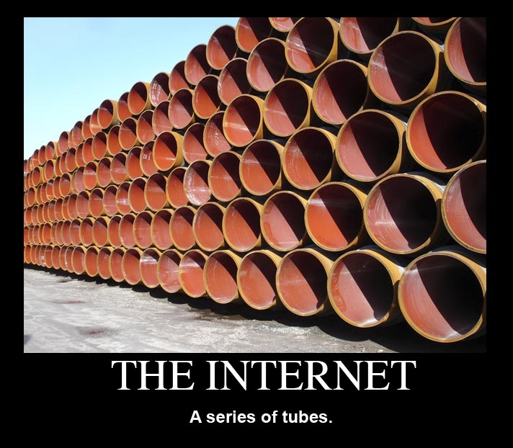
The Internet

Slide 3
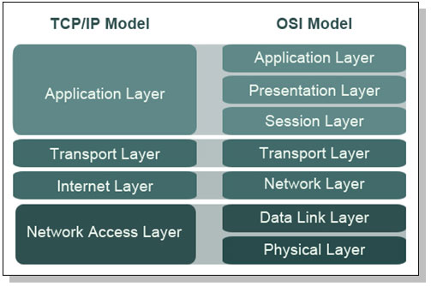
TCP/IP & OSI

Slide 4
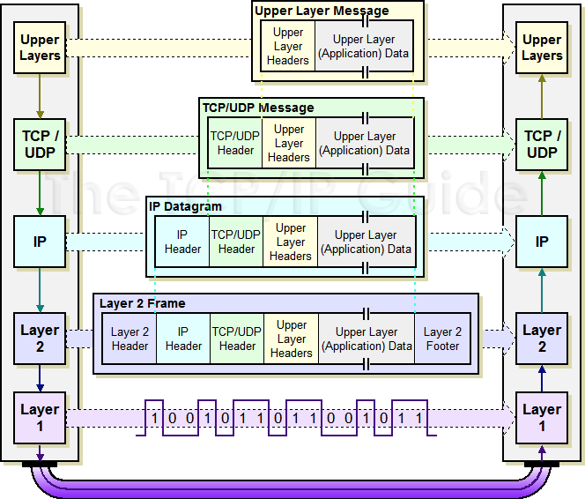

Slide 5
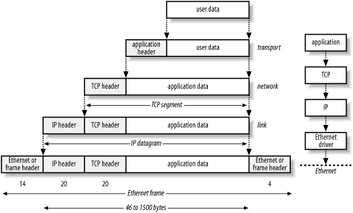

Slide 6
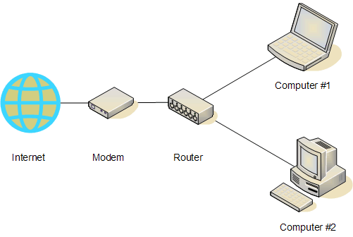
Routing
In the most basic form..

Slide 7
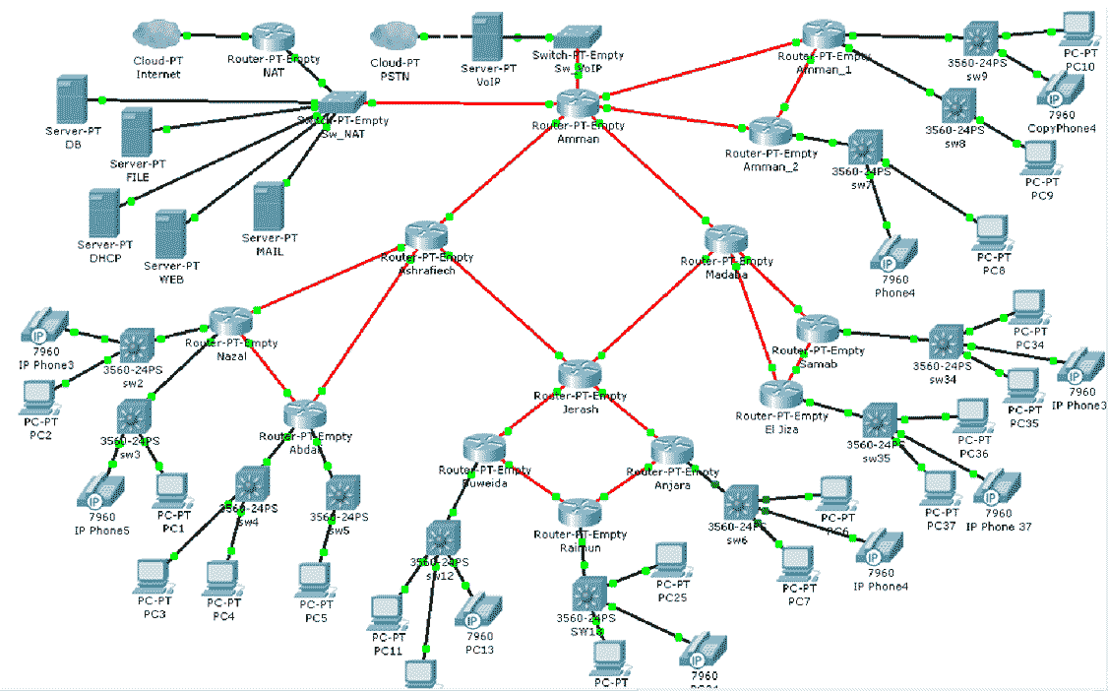

Slide 8
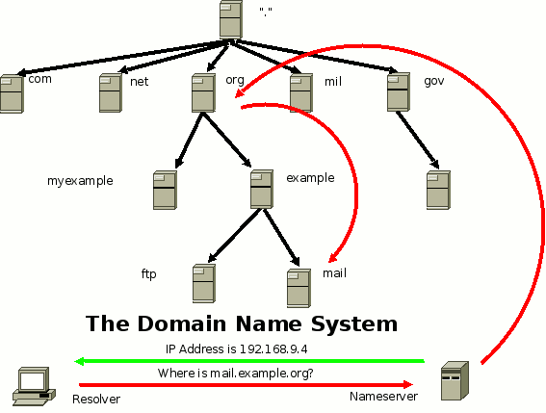
DNS

Slide 9
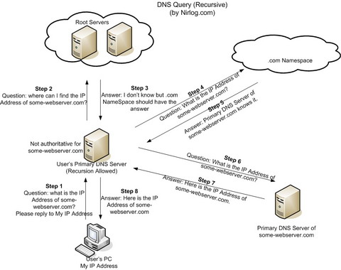
DNS

Slide 10
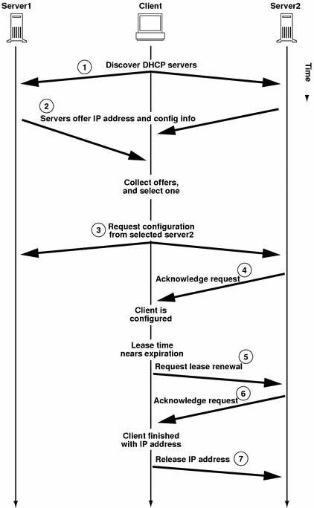
DHCP

Slide 11
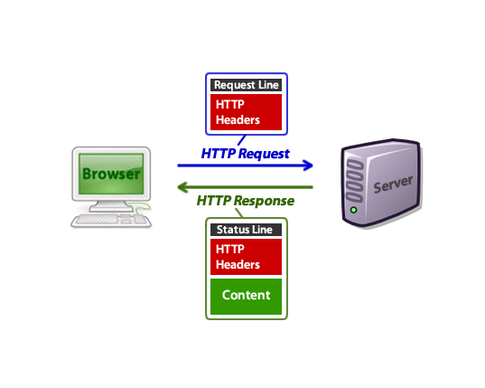
HTTP
Show in Burp

Slide 12
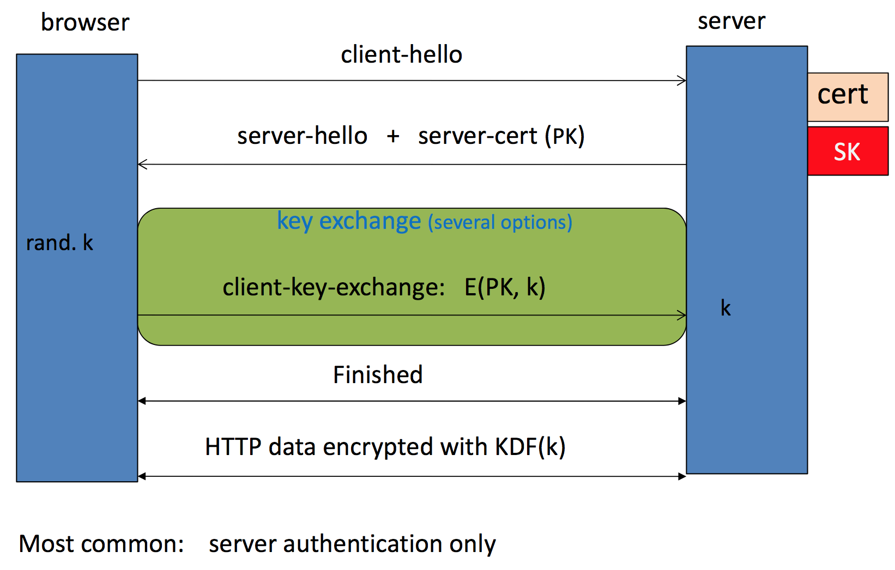
Brief Overview of SSL/TLS

Slide 13
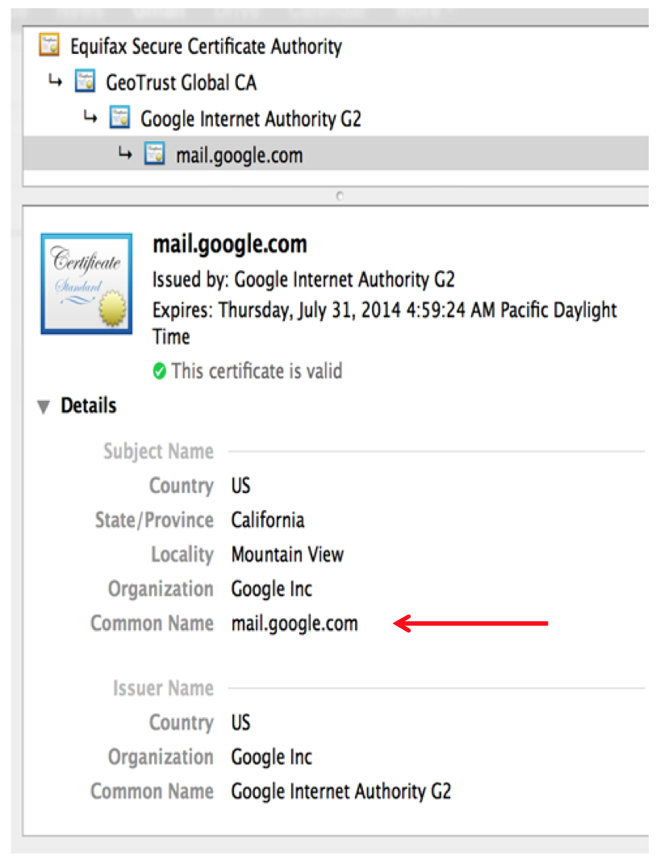
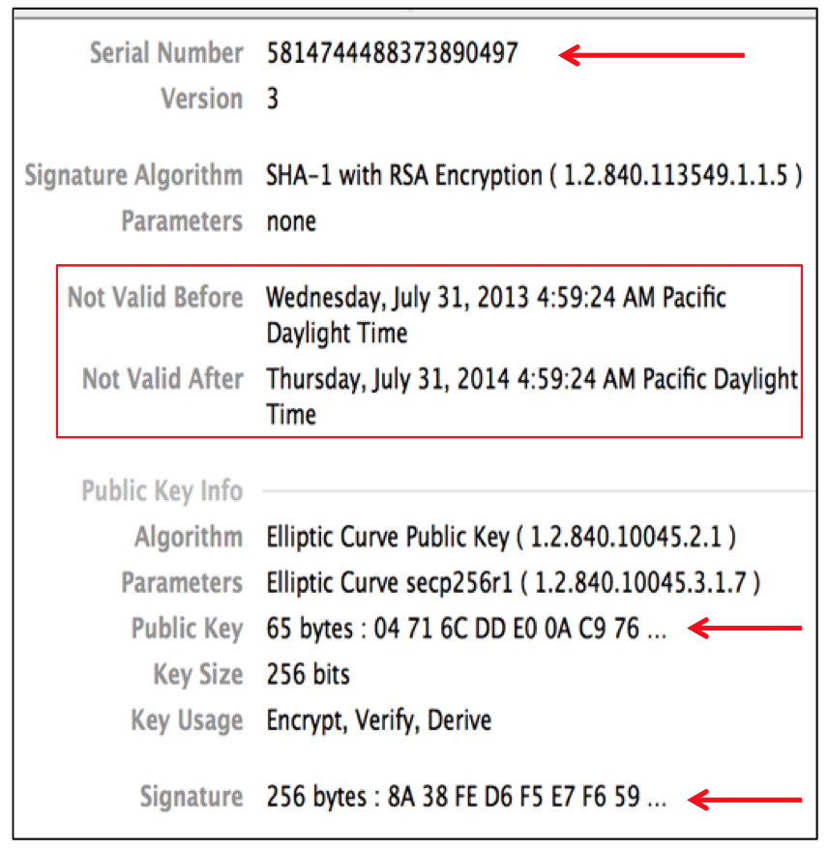
Certificates
Important Fields:

Slide 14
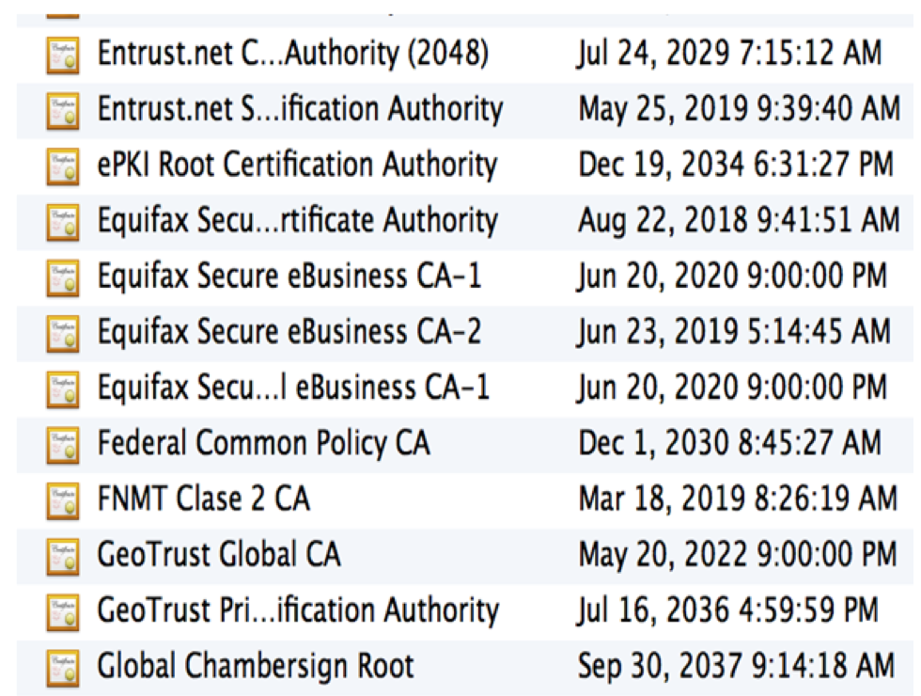
Certificate Authorities
Browsers accept certificates from a large number of CAs
Top level CAs ≈ 60
Intermediate CAs ≈ 1200

Slide 15
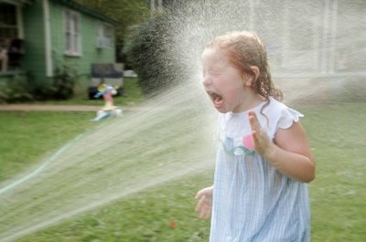

Slide 16

URLs

Slide 17
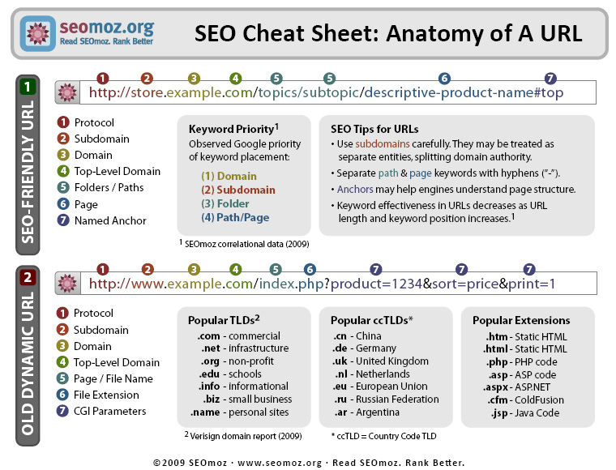
=

Slide 18
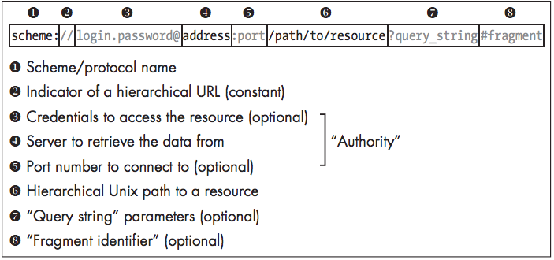

Slide 19
URL Characters
Unreserved
The alphanumerical upper and lower case character may optionally be encoded:
A B C D E F G H I J K L M N O P Q R S T U V W X Y Z
a b c d e f g h i j k l m n o p q r s t u v w x y z
0 1 2 3 4 5 6 7 8 9 - _ . ~
Reserved
Special symbols must sometimes be percent-encoded:
! * ' ( ) ; : @ & = + $ , / ? % # [ ]
Further details can for example be found in
RFC 3986
http://www.w3.org/Addressing/URL/uri-spec.html
Source: https://en.wikipedia.org/wiki/Uniform_resource_locator

Slide 20
URL Schemes
Tons of supported schemes
https://www.iana.org/assignments/uri-schemes/uri-schemes.xhtml
Supporting these can lead so some weirdness
Common ones you may see:
file://
ftp://
http://
https://
mailto://
sms://

Slide 21
Things can get weird
http://127.0.0.1/
This is a canonical representation of an IPv4 address.
http://0x7f.1/
This is a representation of the same address that uses a hexadecimal number to represent the first octet and concatenates all the remaining octets into a single decimal value.
http://017700000001/
The same address is denoted using a 0-prefixed octal value, with all octets concatenated into a single 32-bit integer.
http://example.com&gibberish=1234@167772161/
Where do you think this goes?
http://example.com\@coredump.cx/
How about this one?
http://example.com;.coredump.cx/
And this?
Source: Tangled Web by Michal Zalewski (pages 26 and 30)

Slide 22
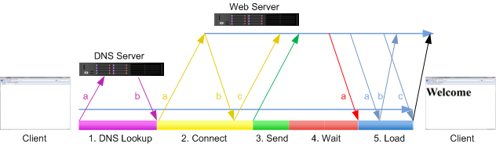
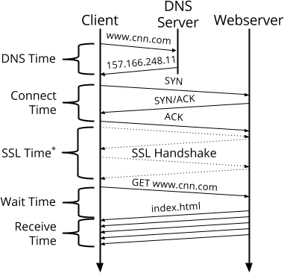
Browser Requests

Slide 23
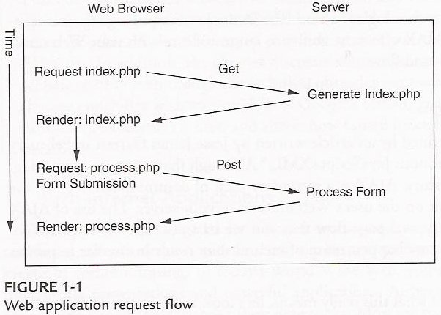
HTTP Requests

Slide 24
HTTP Request/Response
POST /fuzzy_bunnies/bunny_dispenser.php HTTP/1.1
Host: www.fuzzybunnies.com
User-Agent: Bunny-Browser/1.7
Content-Type: text/plain
Content-Length: 17
Referer: http://www.fuzzybunnies.com/main.html
I REQUEST A BUNNY
HTTP/1.1 200 OK
Server: Bunny-Server/0.9.2
Content-Type: text/plain
Connection: close
BUNNY WISH HAS BEEN GRANTED

Slide 25
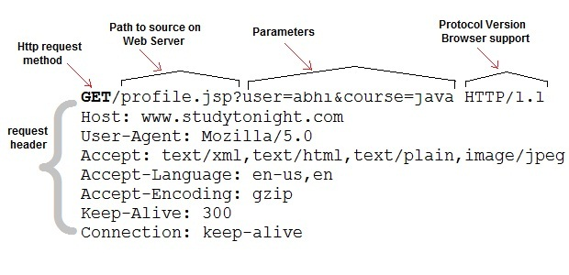
GET Request

Slide 26
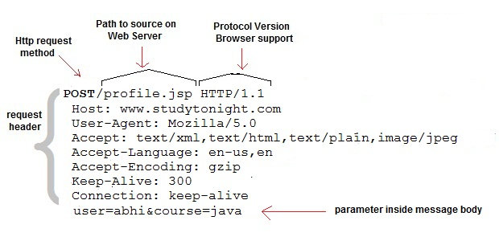
POST Request

Slide 27
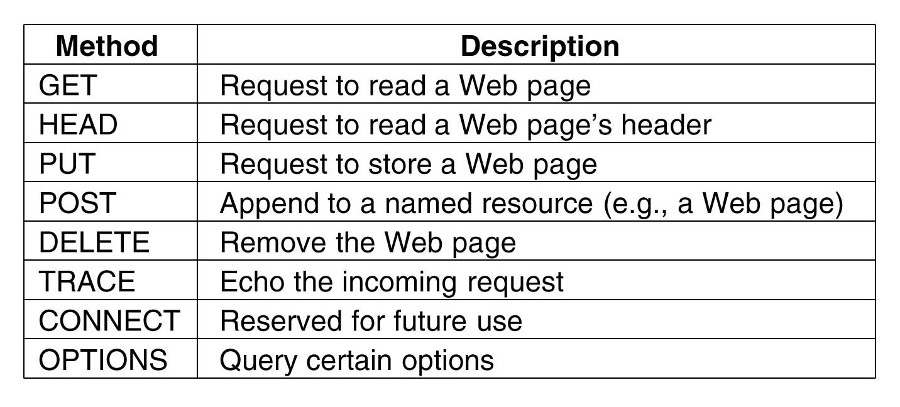
HTTP Methods

Slide 28
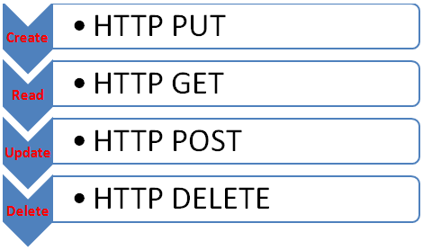

Slide 29
HTTP Headers
Define the operating parameters of the HTTP transaction
There are tons “official” ones:
https://en.wikipedia.org/wiki/List_of_HTTP_header_fields
Colon separated
Ultimately they can be whatever you want
No limit on size of name or value

Slide 30
Cookies
A small bit of data sent by a web server to a browser that is stored by the browser and sent back with subsequent requests
Designed to provide a storage mechanism for stateful information and record a user’s browsing activity
Structure
Name
Value
0+ attributes

Slide 31
Cookie Attributes
Domain and Path
Defines scope of cookie
Expires and Max-age
Defines when the browser should delete the cookie
Secure
Directs the browser on whether or not to send the cookie over encrypted connection only or not
HttpOnly
Directs the browser on JavaScripts access to the cookie

Slide 32
Cookies
GET /index.html HTTP/1.1
Host: www.example.org
...
HTTP/1.0 200 OK
Content-type: text/html
Set-Cookie: theme=light
Set-Cookie: sessionToken=abc123; Expires=Wed, 09 Jun 2021 10:18:14 GMT
...
GET /spec.html HTTP/1.1
Host: www.example.org
Cookie: theme=light; sessionToken=abc123
...

